Slide 1

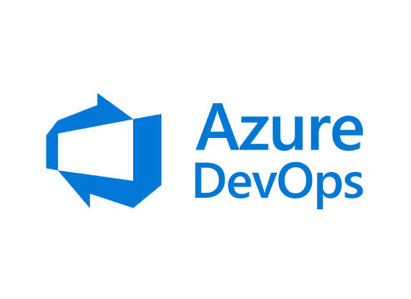
Training
SIKA
Azure DevOps with Power Apps

Slide 2
Today's Goals
Explore Azure DevOps with Power Apps main features: Environments, Solutions, Pipelines and Source Control.
What is Powe Apps DevOps, ALM main concepts
Manage Power Apps Environments
Import an existing Power Apps Solution
Create pipelines to add a solution to Source Control
Create pipelines to publish a solution to Target Environment

Slide 3
ALM in Power Apps
Environnements & Solutions
Geting it Done (configuration)
Pipelines for Repositories
Pipelines for Release
Data Source management (change name)
1
2
3
4
5
6

Slide 4
Prerequisites
Creating Azure DevOps account
https://azure.microsoft.com/en-us/services/devops/
Power Platform Build Tools
Power Platform Build Tools (2.0.7) - Visual Studio Marketplace
Power Apps Account
https://make.powerapps.com/
Azure Active Directory
http://portal.azure.com/

Slide 5
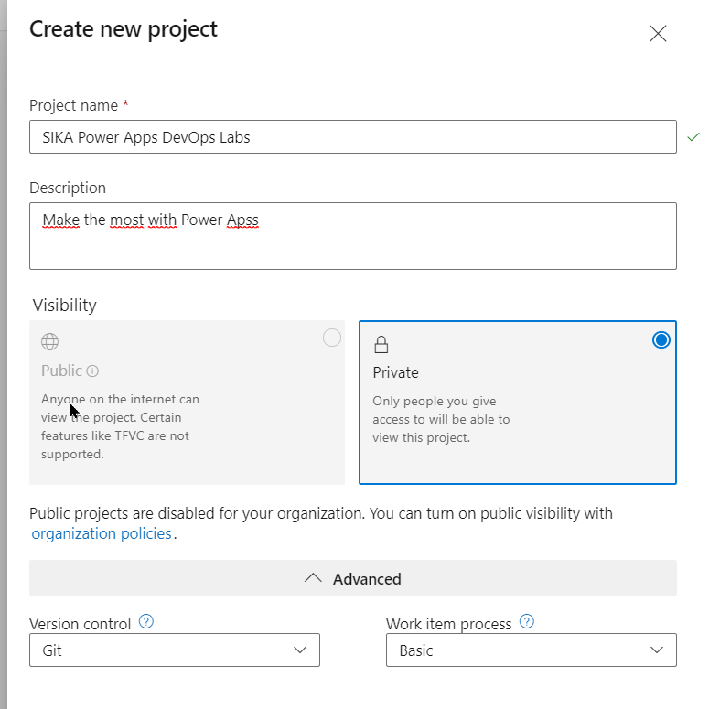
Prerequisites – Create a Demo Project
Go to Azure DevOps
Create a new Project (one per user)
Project name: SIKA Power Apps DevOps Labs
Work item process: Basic

Slide 6
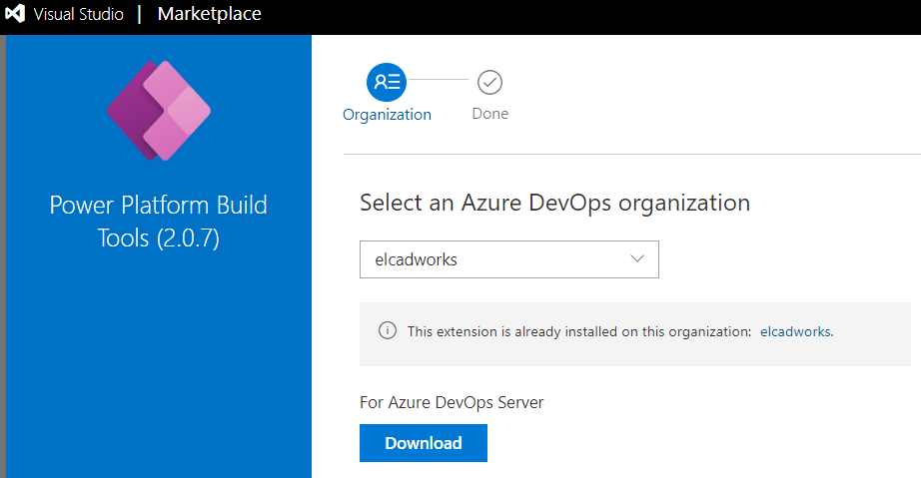
Prerequisites – Add Power Platform Build tools to Organization
Power Platform Build Tools
Select organization
Install Tools

Slide 7
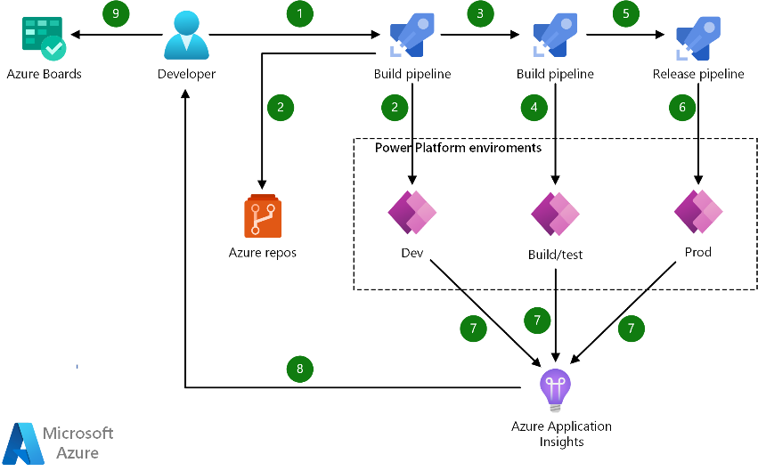
The GOAL

Slide 8
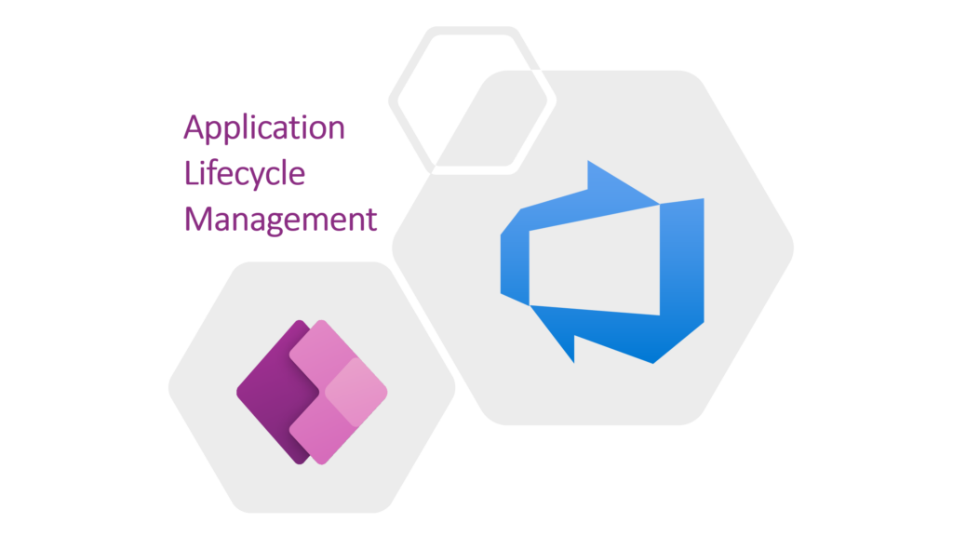
Power Apps ALM

Slide 9
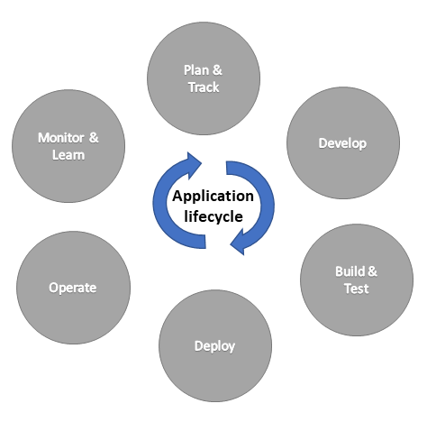
ALM in Power Platform
ALM -> The application lifecycle is the cyclical software development process that involves these areas: plan and track, develop, build and test, deploy, operate, monitor, and learn from discovery (more info here)

Slide 10
Power Platform important concepts
Environments: space/containers to store, manage, and share your organization's business data, apps, and business processes. They also serve to separate apps that might have different roles, security requirements, or target audiences. (each as its own Dataverse database)
Solutions: Solutions are used to transport apps and components from one environment to another, or to apply a set of customizations to existing apps

Slide 11

Work Items

Slide 12
Import Work Items
Download work-items.csv file from https://downgit.github.io/#/home?url=https:%2F%2Fgithub.com%2FJNeto00%2FPowerAppsDevOps%2Fblob%2F560e7f0f717ee12a80985aff3d748615c1ab4d61%2FPowerAppsDevOpsHandsOn.csv
( https://tinyurl.com/3kczuvy5 )
Go to Azure DevOps Boards
Click Work items
Click Import Work Items
Select PowerAppsDevOpsHandsOn.csv file and click Import
Save items

Slide 13
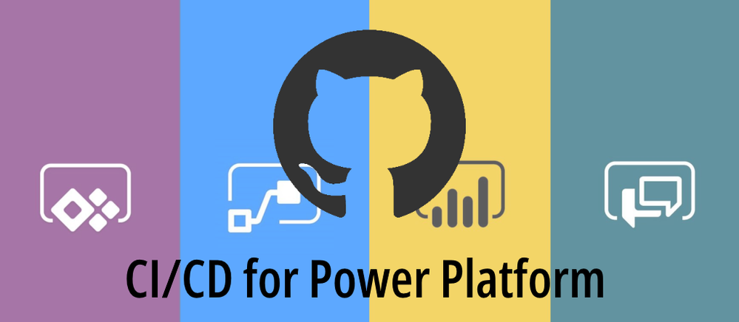
Geting it Done (configuration)

Slide 14
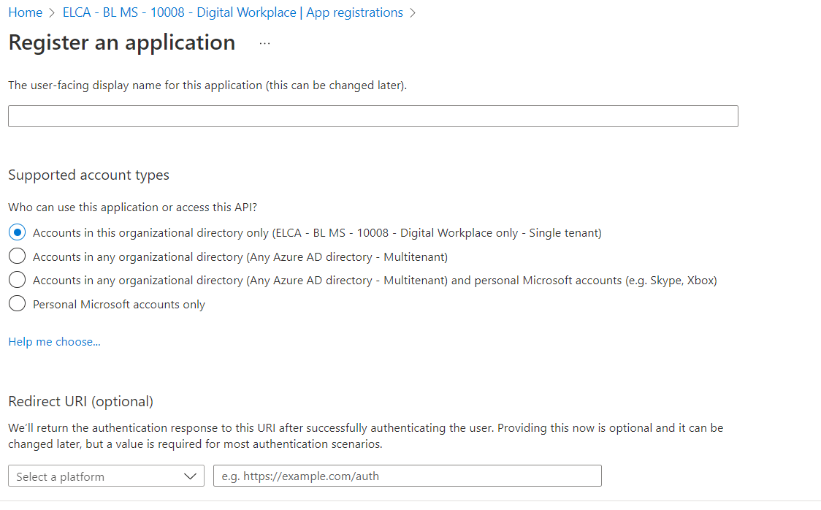
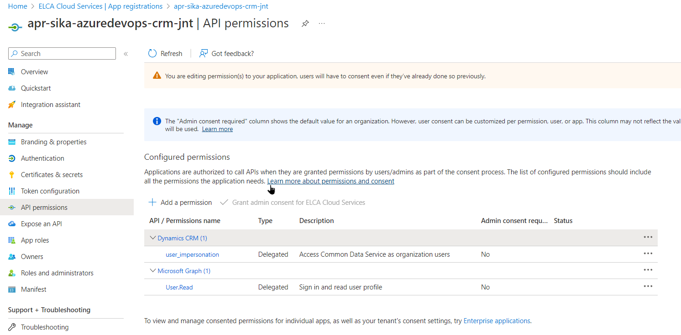
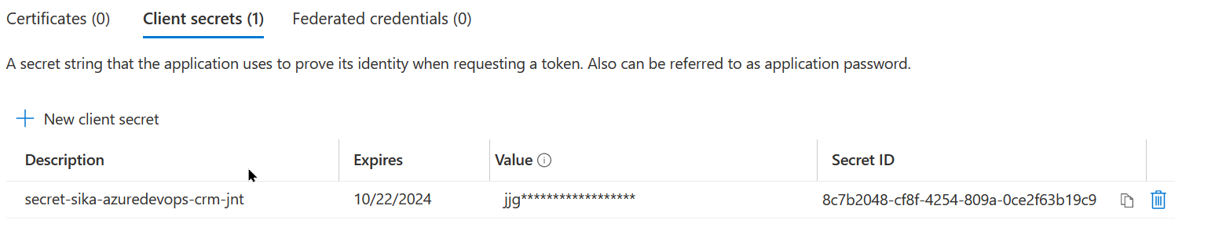
Azure AD –App Registration
AAD -> App registration
App registration -> New client secret (save value!)

Slide 15
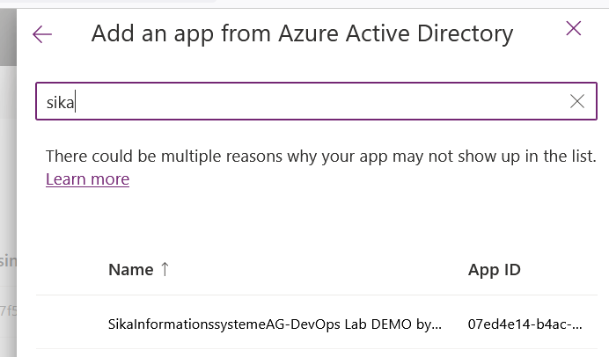
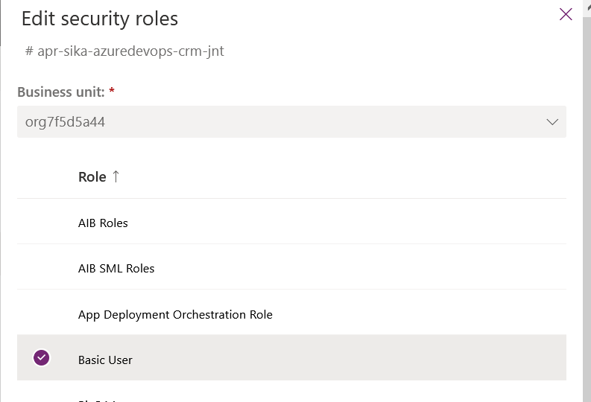
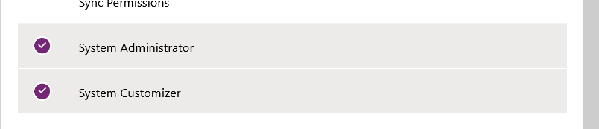
Power Apps – Environment App User
Power Apps -> Environnement Configuration
Go to -> Admin Center -> Environments (your) -> S2S Apps
New app user -> select previous created app

Slide 16
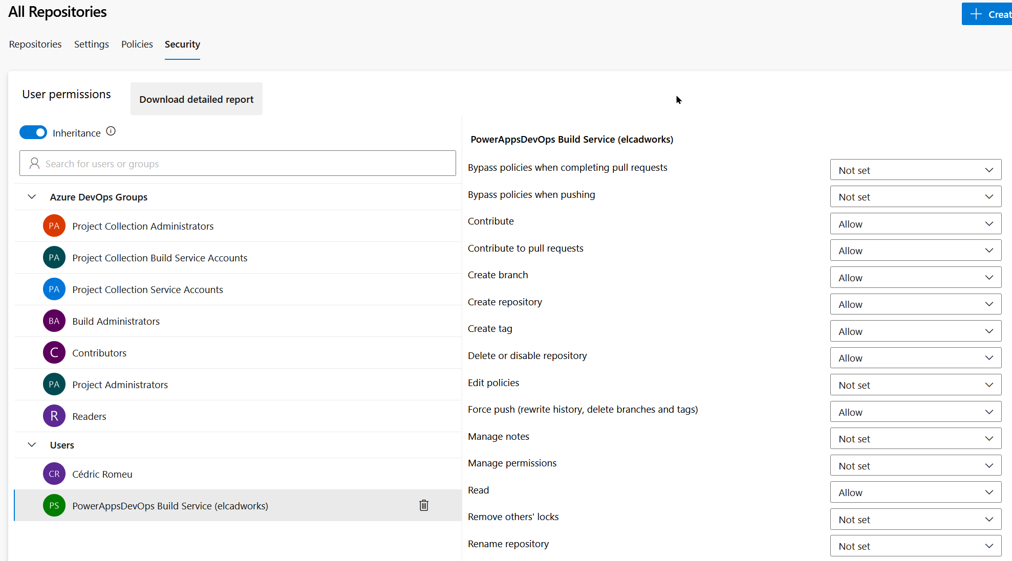
Azure DevOps – Project Settings
Azure DevOps -> Project Settings
Repositories -> Security
Check that the build service as Contribute set to «Allow»

Slide 17
PipeLine for Repository integration - CI
Link: https://learn.microsoft.com/en-us/azure/devops/pipelines/build/variables?view=azure-devops&tabs=yaml

Slide 18
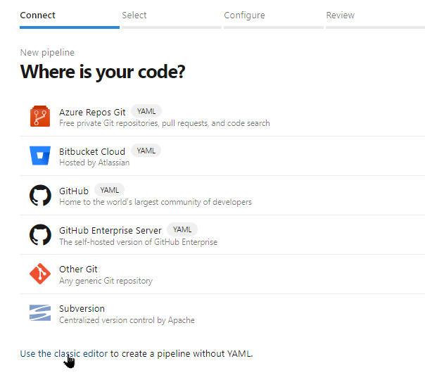
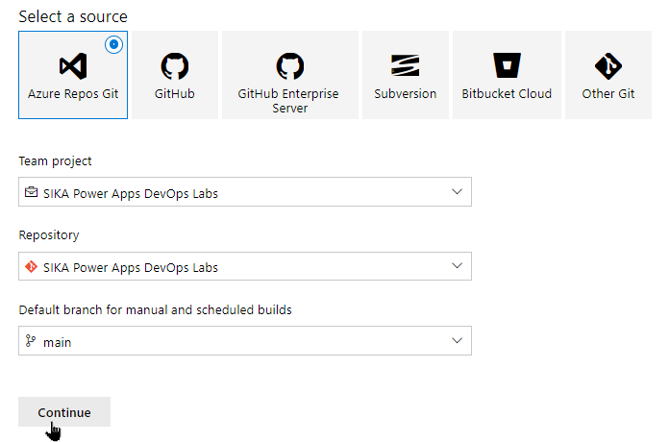
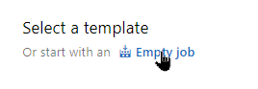
Azure DevOps - Create Pipeline
Repos -> Initialise new branch
Pipelines -> New pipeline (name: Content Integration)

Slide 19
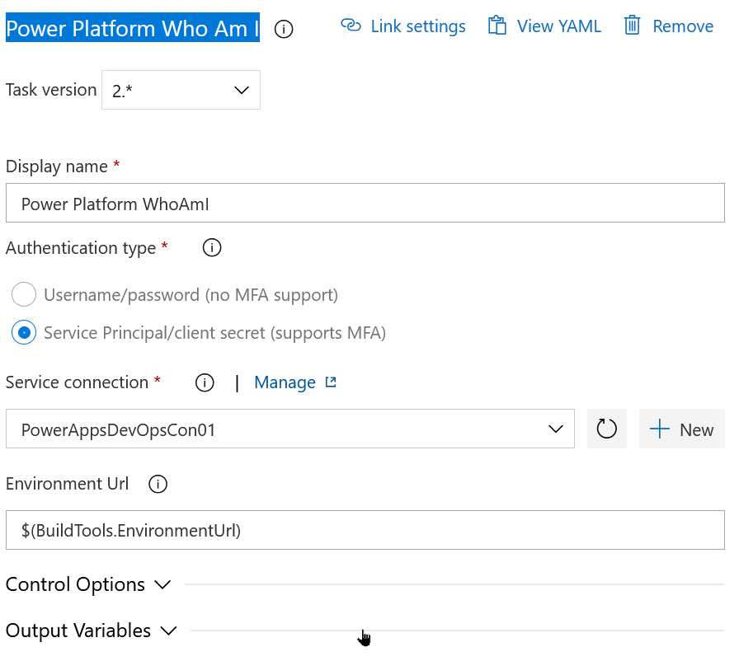
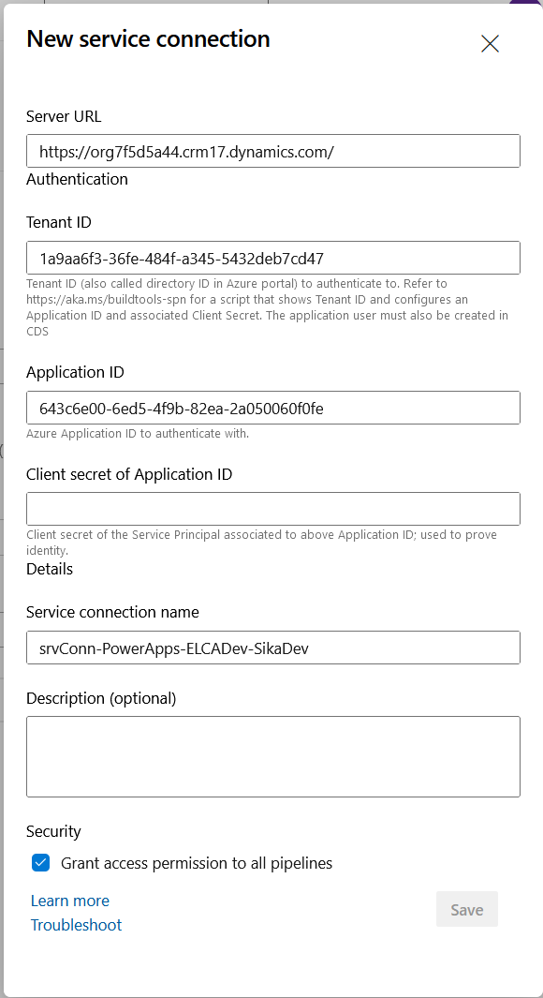
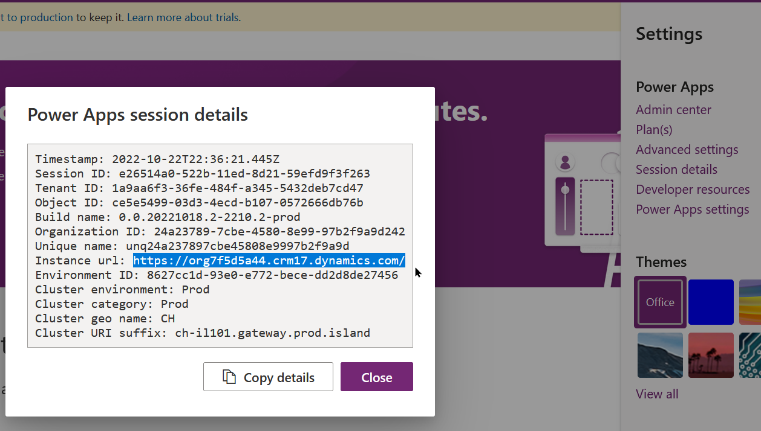
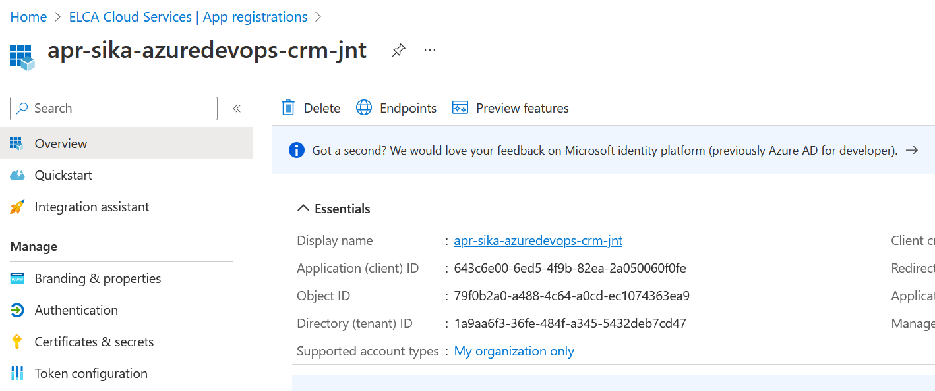
Azure DevOps – Build Pipeline I
Add task -> Power Platform Tool Installer
Add task -> Power Platform Who Am I -> New Service Connection

Slide 20
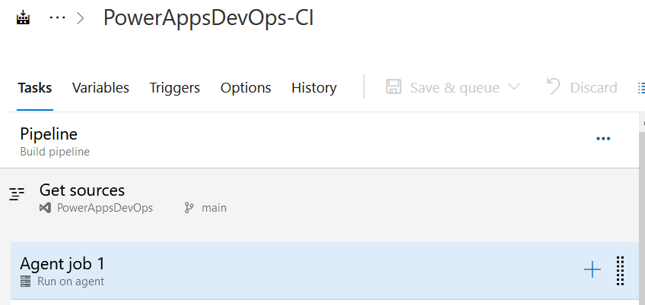
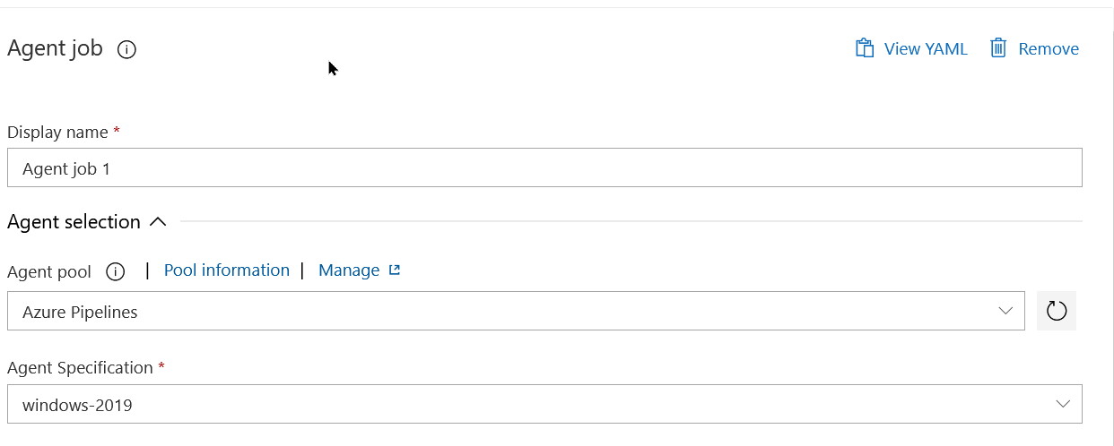
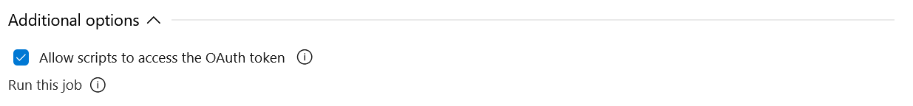
Azure DevOps – Build Pipeline II
Edit Pipeline -> Configure Agent Job 1

Slide 21
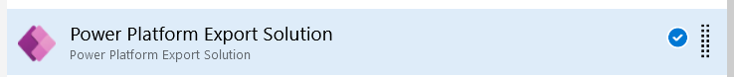
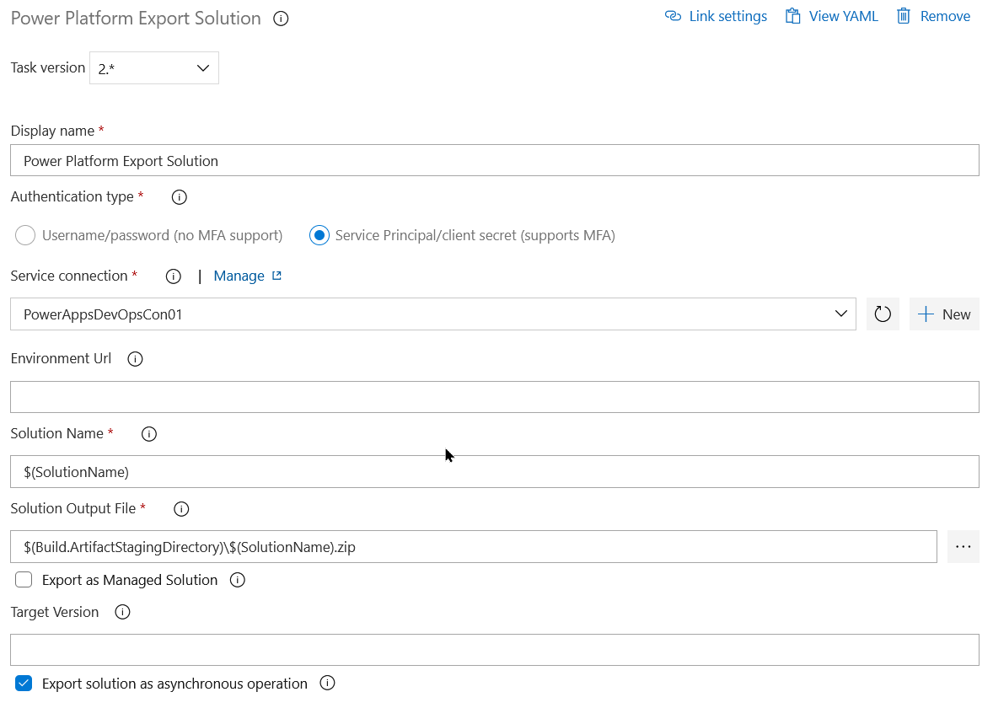
Azure DevOps – Build Pipeline II
Add task -> Power Platform Export Solution
Create a Variable -> SolutionName – SIKAPowerPlatformDevOps[your initials]
Solution Name: $(Build.ArtifactStagingDirectory)\$(SolutionName).zip

Slide 22
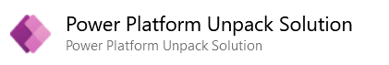
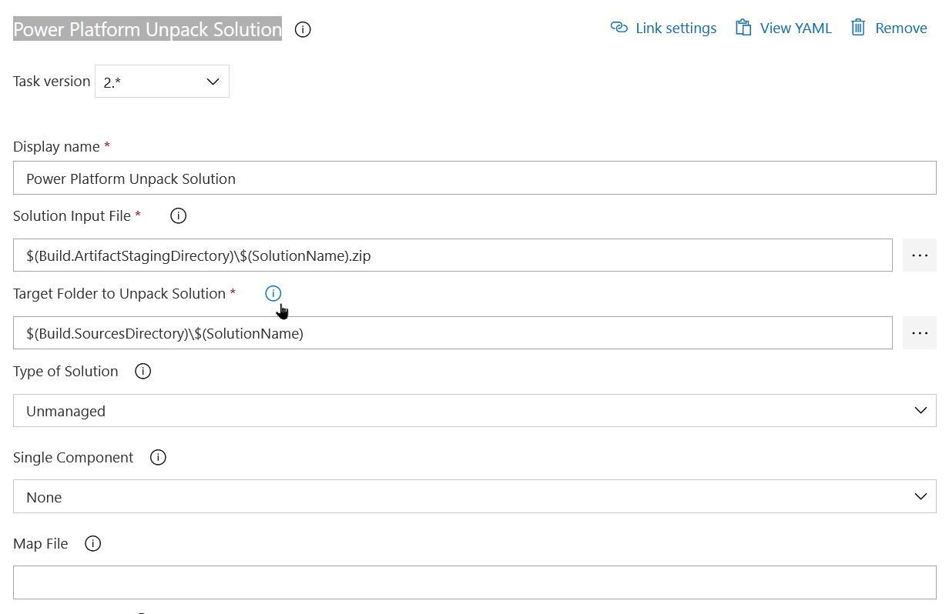
Azure DevOps – Build Pipeline III
Add task -> Power Platform Unpack Solution
Solution Input File: $(Build.ArtifactStagingDirectory)\$(SolutionName).zip Target Folder to Unpack Solution: $(Build.SourcesDirectory)\$(SolutionName)

Slide 23
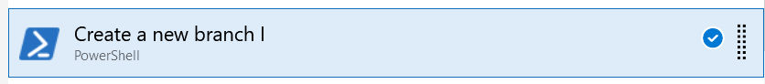
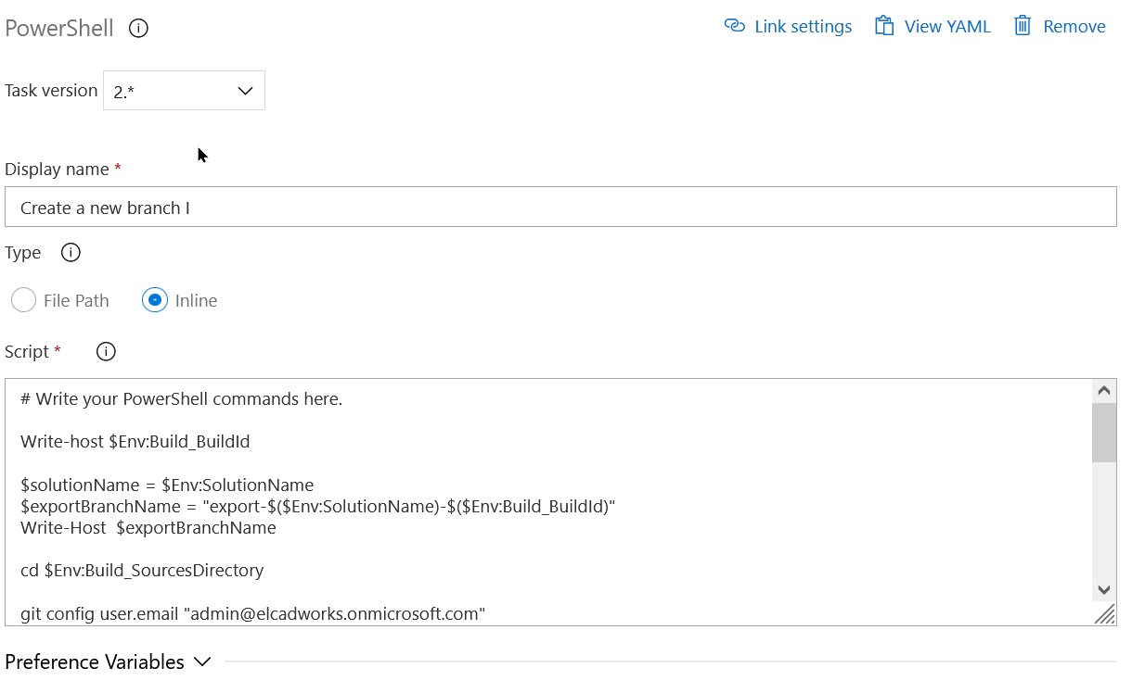
Azure DevOps – Build Pipeline IV
Add task -> Powershell
# Write your PowerShell commands here.
Write-host $Env:Build_BuildId
$solutionName = $Env:SolutionName
$exportBranchNameBuild = "export-$($Env:SolutionName)-$($Env:Build_BuildId)"
$exportBranchName = "export-$($Env:SolutionName)"
Write-Host $exportBranchName
cd $Env:Build_SourcesDirectory
git config user.email "admin@elcadworks.onmicrosoft.com"
git config user.name "Automatic Build"
Write-Host checking out....
git checkout -b $exportBranchNameBuild
git fetch
git add --all
git commit -m "$($Env:SolutionName)-$($Env:Build_BuildId)"
Write-Host 2
git checkout -b $exportBranchName --track origin/$exportBranchName
git merge -X theirs $exportBranchNameBuild --commit
Write-Host 3
git -c http.extraheader="AUTHORIZATION: bearer $($Env:System_AccessToken)" push
Write-Host "Done here"

Slide 24
PipeLine for Content Build

Slide 25
Azure DevOps - Create Pipeline
Pipelines -> New pipeline (name: Content Build)

Slide 26
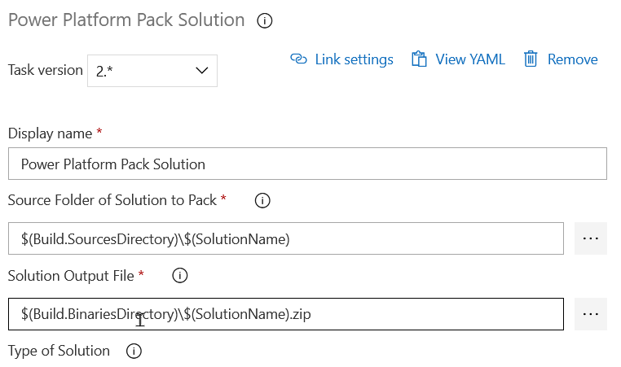
Azure DevOps – Build Pipeline I
Add task -> Power Platform Tool Installer
Add task -> -> new service connection (sika dev)
Source Folder of Solution to Pack: $(Build.SourcesDirectory)\$(SolutionName) Solution Output File: $(Build.BinariesDirectory)\$(SolutionName).zip

Slide 27
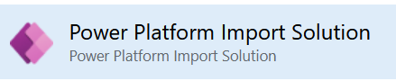
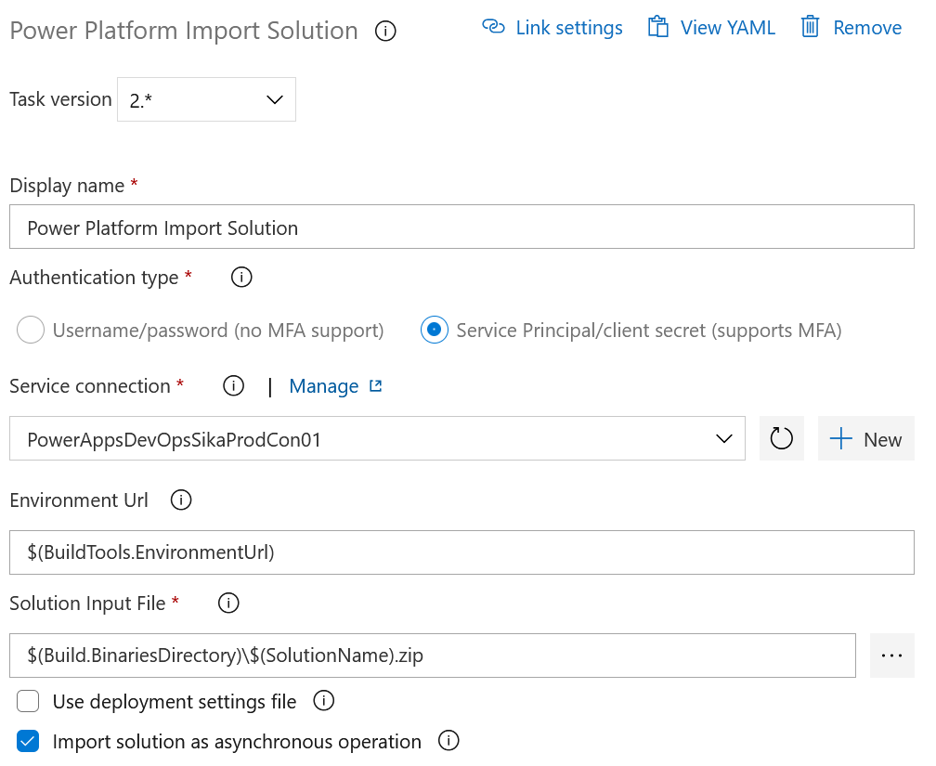
Azure DevOps – Build Pipeline II
Add task ->
Service connection: [dev environment]
Solution Input File: $(Build.BinariesDirectory)\$(SolutionName).zip

Slide 28
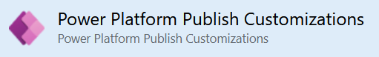
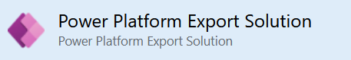
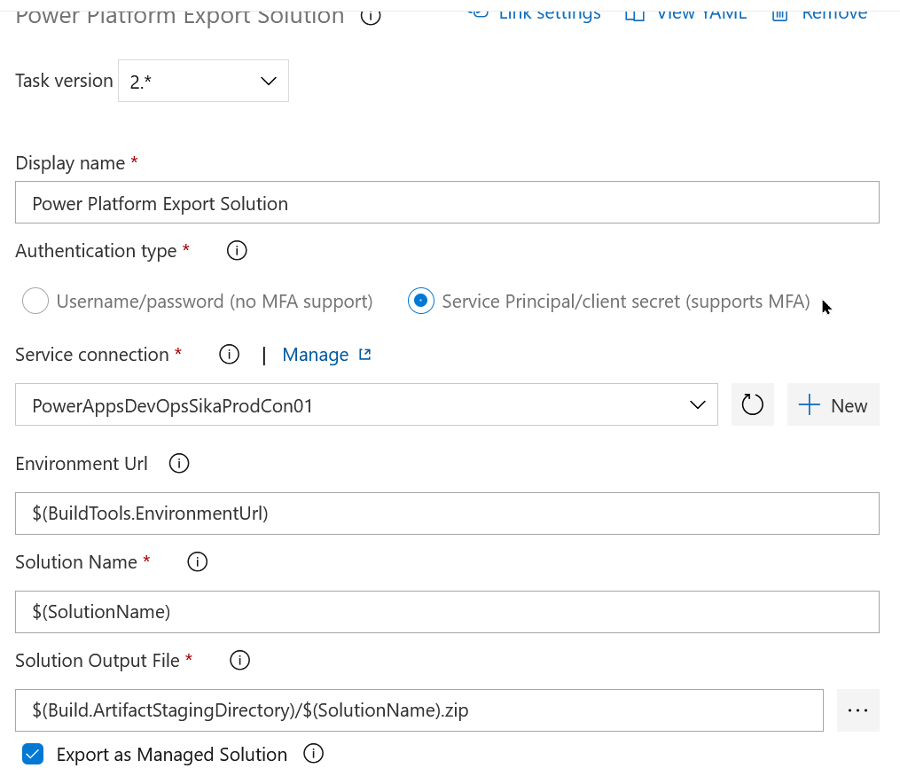
Azure DevOps – Build Pipeline III
Add task ->
Add task ->
Service connection: [dev environment]
Solution Output File :
$(Build.ArtifactStagingDirectory)/$(SolutionName).zip
Export as Managed Solution

Slide 29
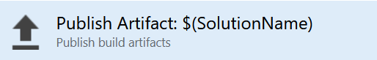
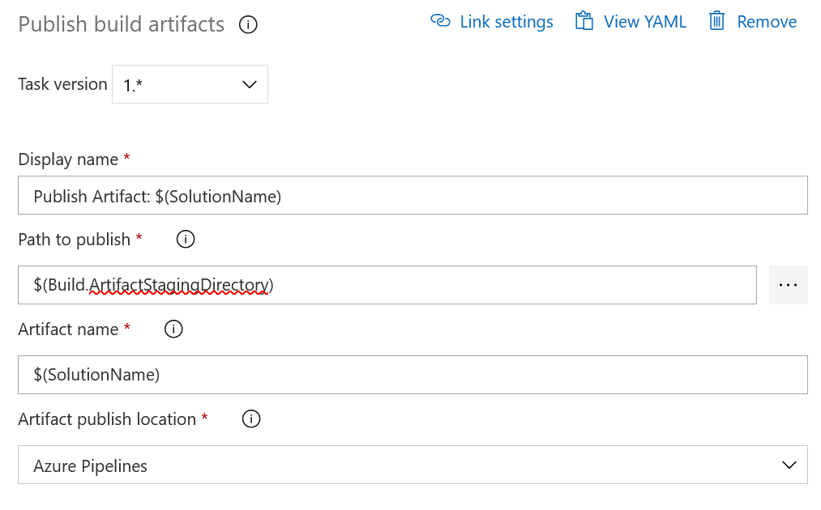
Azure DevOps – Build Pipeline IV
Add task ->
Service connection: [dev environment]
Path to publish: $(Build.ArtifactStagingDirectory)
Publish to Azure Pipelines

Slide 30
PipeLine for Content Build (UAT)

Slide 31
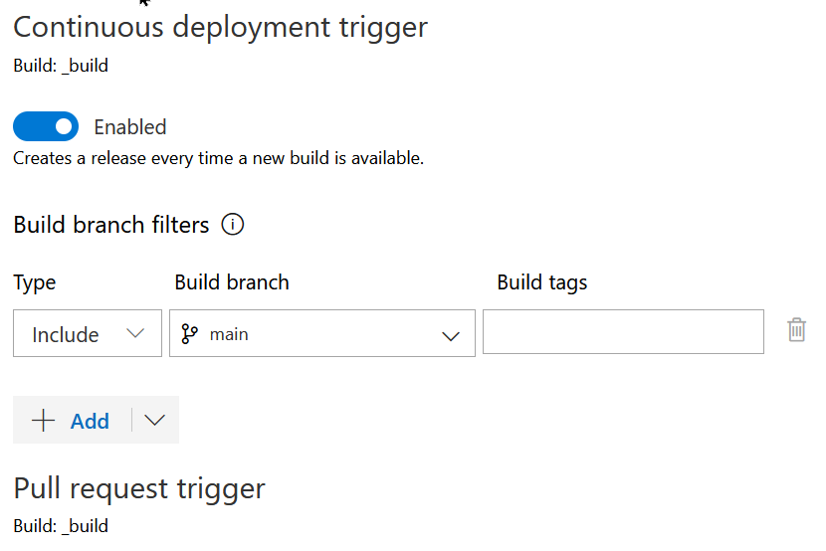
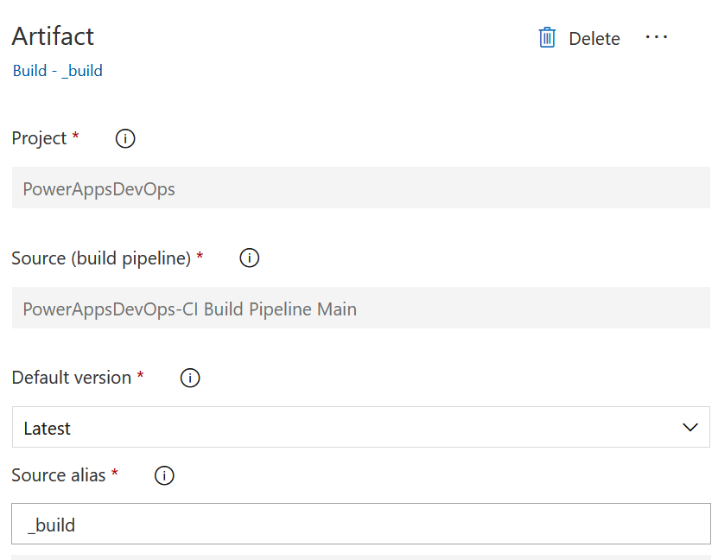
Azure DevOps - Create Release Pipeline
Pipelines -> New release pipeline (name: Release UAT)
Select Empty job

Slide 32
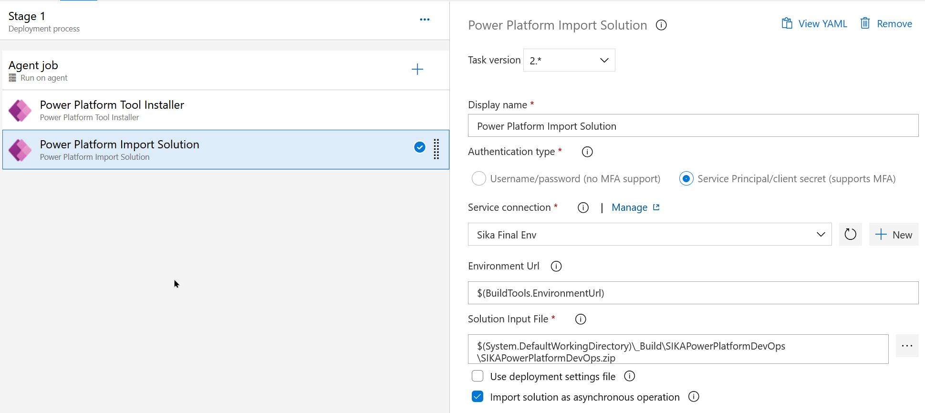
Azure DevOps – Build Release Pipeline II
Stage 1 ->
Connection: SIKA UAT
Solution Input File: $(System.DefaultWorkingDirectory)\_Build\SIKAPowerPlatformDevOps\SIKAPowerPlatformDevOps.zip

Slide 33
Orchestration

Slide 34
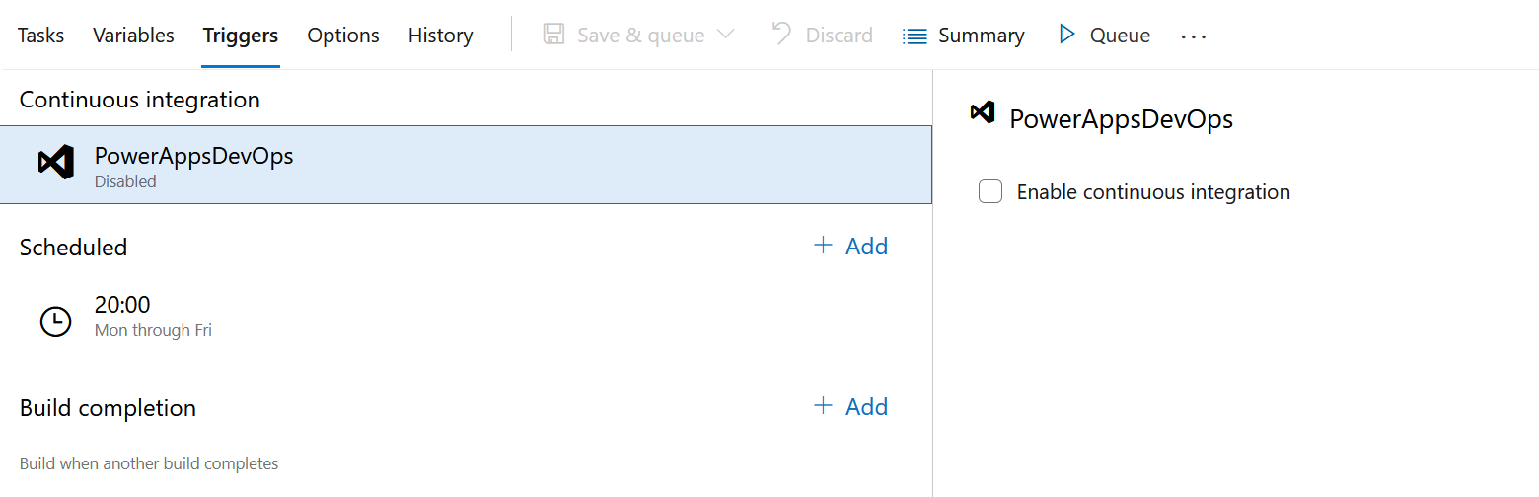
Azure DevOps – Schedule Dev Integration
Pipeline -> Content Integration

Slide 35
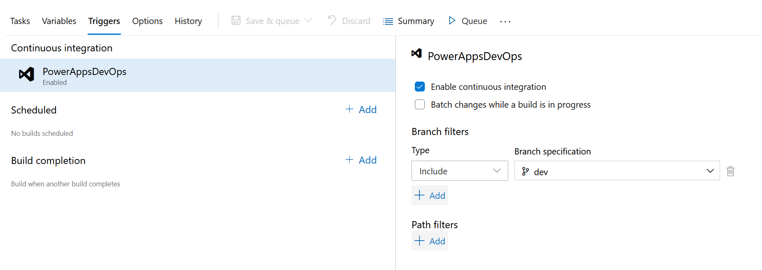
Azure DevOps – Schedule Dev Integration
Pipeline -> Content Build

Slide 36
Fabian Nicollier
fabian.nicollier@elca.ch

